Slide 1
Topic: Sine and Cosine Rules
EQ: What are the sine and cosine rules and when do we apply them?

Slide 2
Topic: Sine and cosine Rules EQ: What are the sine and cosine rules and when do we use them?
Summary:

Slide 3
Topic: Sine and cosine Rules EQ: What are the sine and cosine rules and when do we use them?
If the question concerns lengths or angles in a triangle, you may need the sine rule or the cosine rule. How to know:
First, decide if the triangle is right-angled.
Then, decide whether an angle is involved at all.
If it is a right-angled triangle, and there are no angles involved, you will need Pythagoras’ Theorem
If it is a right-angled triangle, and there are angles involved, you will need straightforward Trigonometry, using Sin, Cos and Tan.
If the triangle is not right-angled, you may need the Sine Rule or the Cosine Rule

Slide 4
Topic: Sine and cosine Rules EQ: What are the sine and cosine rules and when do we use them?
The Sine Rule:
C
Not right-angled!
b
a
A
B
c
In any triangle ABC
or

Slide 5
Topic: Sine and cosine Rules EQ: What are the sine and cosine rules and when do we use them?
The Sine Rule:
C
b
a
A
B
c
You can only use the Sine Rule if you have a “matching pair”.
You have to know one angle, and the side opposite it.
Then if you have just one other side or angle, you can use the Sine Rule to find any of the other angles or sides.

Slide 6
Topic: Sine and cosine Rules EQ: What are the sine and cosine rules and when do we use them?
Finding the missing side:
Not to scale
10cm
x
40°
65°
Is it a right-angled triangle?
No
Is there a matching pair?
Yes

Slide 7
Topic: Sine and cosine Rules EQ: What are the sine and cosine rules and when do we use them?
Finding the missing side:
C
Not to scale
b
10cm
a
x
A
40°
c
65°
B
Is it a right-angled triangle?
No
Is there a matching pair?
Yes
Use the Sine Rule
Label the sides and angles.

Slide 8
Topic: Sine and cosine Rules EQ: What are the sine and cosine rules and when do we use them?
Finding the missing side:
Not to scale
C
b
10cm
a
x
A
40°
c
65°
B
Because we are trying to find a missing length of a side, the little letters are on top
We don’t need the “C” bit of the formula.

Slide 9

Yesterday’s Starter
Can you find the value of x in this diagram to 2dp? Be careful with rounding!
My answer (there may be more than one). Step:
cos24$°$ = $\frac{12}{x}$; x = $\frac{12}{cos24°}$ = 13.13563534cm
tan42$°$ = $\frac{x}{8}$; x = tan42$°$ x 8 = 7.20323235cm
13.13563534cm - 7.20323235cm = 5.93240299cm
5.93240299cm + 4cm = 9.93240299cm
sin⁻¹($\frac{9.93240299}{13}$) = 49.82 $°$
NOT TO SCALE
13cm
x
4cm
42°
8cm
24°
12cm

Slide 10
Topic: Sine and cosine Rules EQ: What are the sine and cosine rules and when do we use them?
Finding the missing side:
Not to scale
C
b
10cm
a
x
A
40°
c
65°
B
Because we are trying to find a missing length of a side, the little letters are on top
Fill in the bits you know.

Slide 11
Topic: Sine and cosine Rules EQ: What are the sine and cosine rules and when do we use them?
Finding the missing side:
C
Not to scale
b
10cm
a
x
A
40°
c
65°
B
Fill in the bits you know.

Slide 12
Topic: Sine and cosine Rules EQ: What are the sine and cosine rules and when do we use them?
Finding the missing side:
C
Not to scale
b
10cm
a
x
A
40°
c
65°
B
cm

Slide 13
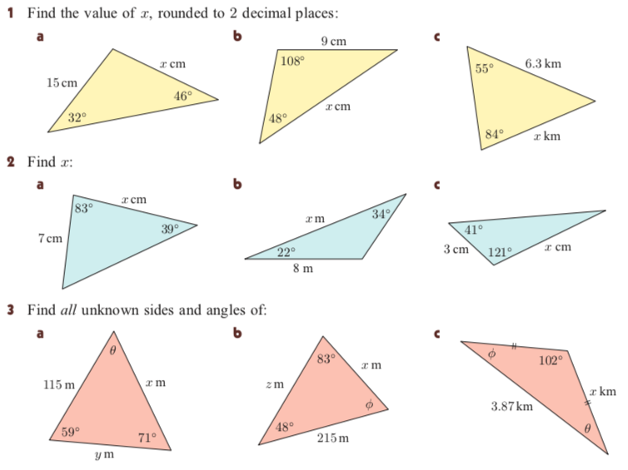
11.05cm
11.52cm
5.19km

Slide 14
Topic: Sine and cosine Rules EQ: What are the sine and cosine rules and when do we use them?
Finding the missing angle:
Not to scale
10cm
7.1cm
θ°
65°
Is it a right-angled triangle?
No
Is there a matching pair?
Yes

Slide 15
Topic: Sine and cosine Rules EQ: What are the sine and cosine rules and when do we use them?
Finding the missing angle:
C
Not to scale
b
10cm
a
7.1cm
A
θ°
c
65°
B
Is it a right-angled triangle?
No
Is there a matching pair?
Yes
Use the Sine Rule
Label the sides and angles.

Slide 16
Topic: Sine and cosine Rules EQ: What are the sine and cosine rules and when do we use them?
Finding the missing angle:
C
Not to scale
b
10cm
a
7.1cm
A
θ°
c
65°
B
Because we are trying to find a missing angle, the formula is the other way up.
We don’t need the “C” bit of the formula.

Slide 17
Topic: Sine and cosine Rules EQ: What are the sine and cosine rules and when do we use them?
Finding the missing angle:
C
Not to scale
b
10cm
a
7.1cm
A
θ°
c
65°
B
Because we are trying to find a missing angle, the formula is the other way up.
Fill in the bits you know.

Slide 18
Topic: Sine and cosine Rules EQ: What are the sine and cosine rules and when do we use them?
Finding the missing angle:
C
Not to scale
b
10cm
a
7.1cm
A
θ°
c
65°
B
Fill in the bits you know.

Slide 19
Topic: Sine and cosine Rules EQ: What are the sine and cosine rules and when do we use them?
Finding the missing angle:
C
Not to scale
b
10cm
a
7.1cm
A
θ°
c
72°
B
Sin ⁻¹ =

Slide 20
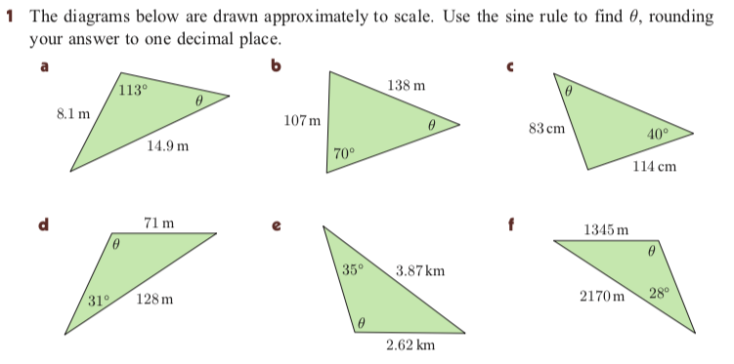

Slide 21
Topic: Sine and cosine Rules EQ: What are the sine and cosine rules and when do we use them?
Homework: 10 ticks Sine and Cosine Law Worksheet
Complete your summary
Summary:

Slide 22
Topic: Sine and cosine Rules EQ: What are the sine and cosine rules and when do we use them?
The Cosine Rule:
If the triangle is not right-angled, and there is not a matching pair, you will need then Cosine Rule.
C
b
a
A
B
c
In any triangle ABC

Slide 23
Topic: Sine and cosine Rules EQ: What are the sine and cosine rules and when do we use them?
Finding the missing side:
c
Not to scale
A
9km
B
20°
x
a
b
12cm
C
Use the Cosine Rule
Is it a right-angled triangle?
No
Label the sides and angles, calling the given angle “A” and the missing side “a”.
Is there a matching pair?
No

Slide 24
Topic: Sine and cosine Rules EQ: What are the sine and cosine rules and when do we use them?
Finding the missing side:
c
Not to scale
A
9km
B
20°
x
a
b
12cm
C
Fill in the bits you know.
x = 4.69cm

Slide 25
Topic: Sine and cosine Rules EQ: What are the sine and cosine rules and when do we use them?
Finding the missing side:
C
Not to scale
A man starts at the village of Chartham and walks 5 km due South to Aylesham. Then he walks another 8 km on a bearing of 130° to Barham.
What is the direct distance between Chartham and Barham, in a straight line?
5km
130°
A
First, draw a sketch.
8km
Is it a right-angled triangle?
No
Is there a matching pair?
No
B
Use the Cosine Rule

Slide 26
Topic: Sine and cosine Rules EQ: What are the sine and cosine rules and when do we use them?
Finding the missing side:
C
Not to scale
A man starts at the village of Chartham and walks 5 km due South to Aylesham. Then he walks another 8 km to on a bearing of 130° to Barham.
What is the direct distance between Chartham and Barham, in a straight line?
5km
b
a
130°
A
8km
c
Call the missing length you want to find “a”
a² = 5² + 8² - 2 x 5 x 8 x cos130°
Label the other sides
a² = 25 + 64 - 80cos130°
a² = 140.42
B
11.85km
a = 11.85

Slide 27
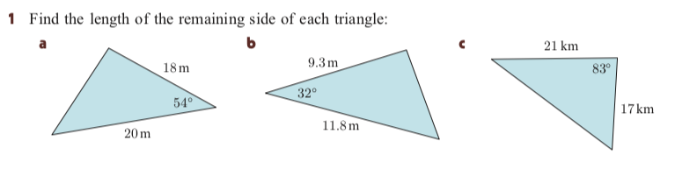
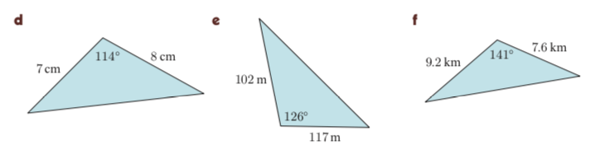

Slide 28
Topic: Sine and cosine Rules EQ: What are the sine and cosine rules and when do we use them?
Finding the missing angle θ:
C
Not to scale
b
a
6cm
9cm
θ°
A
B
10cm
c
Is it a right-angled triangle?
No
Use the Cosine Rule
Is there a matching pair?
No
Label the sides and angles, calling the missing angle “A”

Slide 29
Topic: Sine and cosine Rules EQ: What are the sine and cosine rules and when do we use them?
Finding the missing angle θ:
C
Not to scale
b
a
6cm
9cm
θ°
A
B
10cm
c
Cos ⁻¹ =

Slide 30
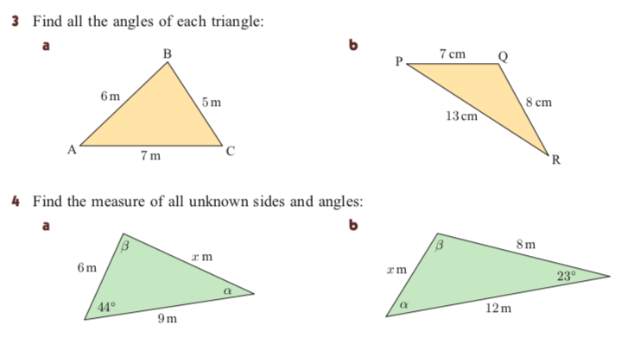

Slide 31
Topic: Sine and cosine Rules EQ: What are the sine and cosine rules and when do we use them?
Homework: 10 ticks Sine and Cosine Law Worksheet
Complete your summary
Summary:

